Slide 1


CPSC 8810: Motion Planning
Path planning of a non-holonomic car using Hybrid A* algorithm
Ajith Kumar Challa
Narahari Rahul Malaynur
Krishna Sai Avinash Pallela

Slide 2
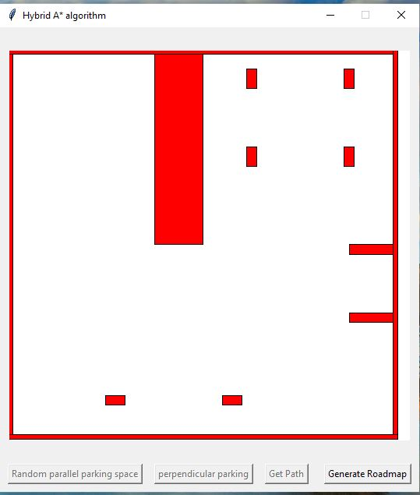
Objective
The objective of this work is to develop and implement a path planning system for a non-holonomic car taking it from an initial configuration to a parking space.
Algorithms that can be used:
RRT* with Dubins curves
Anytime D*
Hybrid A*
1
2
3
4

Slide 3
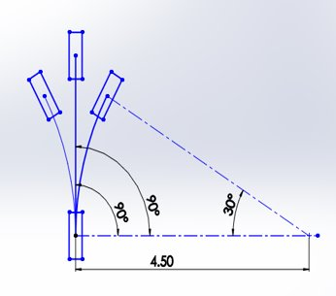
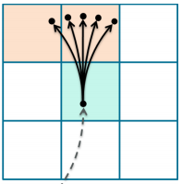
Introduction
What is Hybrid A* algorithm?
Unlike A* algorithm, Hybrid A* algorithm accounts for the kinematic constraints of the vehicle. The achievable configurations from the current configuration can be derived from basic coordinate geometry.
In our case, the car can take 3 configurations:
Go straight for a specified distance.
Left turn at a maximum steering angle.
Right turn at a maximum steering angle.

Slide 4
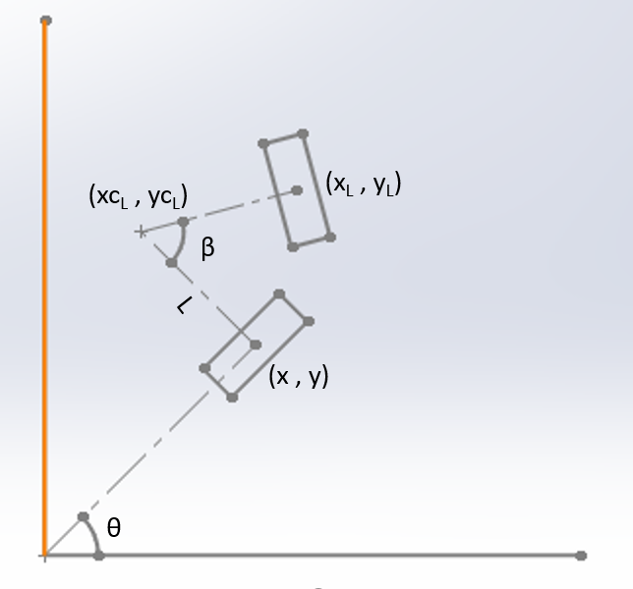
Geometrical representation of parent and child configuration
Generalized formulae using basic coordinate geometry are derived such that the left and right instantaneous centers of the car about which the car rotates is determined irrespective of the car’s orientation.
The variables in the figure are:
(x, y, θ) are coordinates of the parent
(xcL, ycL) is the coordinate of the left instantaneous center
(xL, yL, (θ – β)) is the coordinate of the left child

Slide 5
Calculating coordinates of the children
Considering two equations to calculate two unknowns xcL and ycL,
tan(90 + θ) = (ycL - y) / (xcL – x)
(xcL – x)2 + (ycL - y)2 = L2
Using the above two equations, the coordinates of the left center are obtained as below,
ycL = y + L*cos θ
xcL = x + (y - ycL)*tan θ
After calculating the centers, the coordinates of the children are calculated using the below two equations,
yL = ycL + L*sin(θ – β)
xL = xcL – [(ycL - y) / tan(θ – β)]

Slide 6
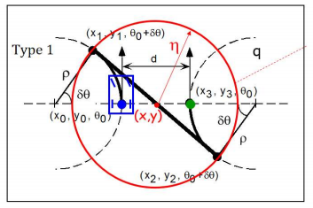
Parking Maneuver
Type-1 maneuver for parallel parking:
The hybrid A* algorithm takes the car to a point less than a specified distance from the goal configuration and calculates ‘d’ and ‘theta’ to execute the type-I maneuver.

Slide 7
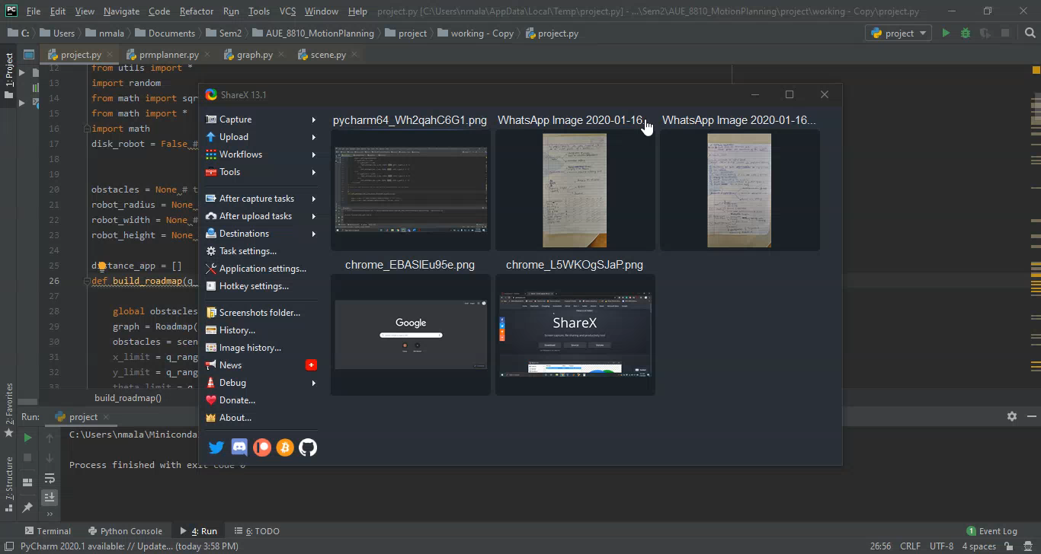
Results

Slide 8
Future works
Heuristics – In this project, heuristics are based on Euclidean distance between two points. Non-holonomic based obstacle heuristics can be used which would reduce the nodes expanded.
Kinematic model – The problem can be accurately dealt by also considering the reverse motion of the car.
Varying steering inputs – Although the car can reach the goal position, the path is constrained by its steering angle. By giving a continuous steering angle, the car can reach the goal by searching lesser nodes.
Notes:
Post processing - The paths produced by hybrid-state A* are often still suboptimal and worthy of further improvement. Empirically, we find that such paths are drivable, but can contain unnatural swerves that require unnecessary steering.

Slide 9
Thank you! Questions?
Notes:
Post processing - The paths produced by hybrid-state A* are often still suboptimal and worthy of further improvement. Empirically, we find that such paths are drivable, but can contain unnatural swerves that require unnecessary steering.

